Slide 1


Energy Prices in Illinois
Computer Science
Noam Yan, Yunqian Bao, Zhicong Fan
12/04/2022

Slide 2

OUTLINE
Introduction
Dataset
Preprocessing
Models
Discussion

Slide 3

INTRODUCTION
COMPUTER SCIENCE
XU YAN, YUNQIAN BAO, ZHICONG FAN

Slide 4
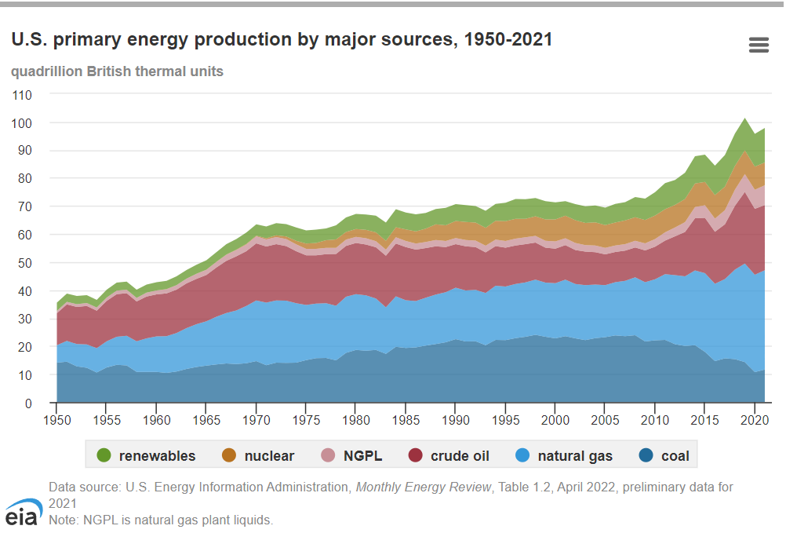
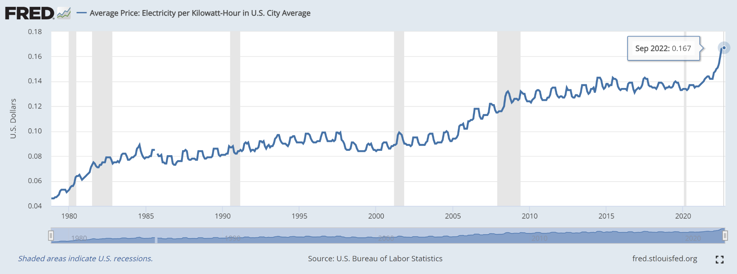
INTRODUCTION
Energy Prices in Illinois
As forecasted by the U.S. federal government, the price of electricity will continue to rise into 2023. What’s more, the prices are already 7.5% higher today than they were in 2021. Energy prices have sure become a problem in the United states. In this project, we are interested in discovering what features are interfering with the prices and using the data these years to predict the prices in Illinois.
COMPUTER SCIENCE
XU YAN, YUNQIAN BAO, ZHICONG FAN

Slide 5
DATASET
COMPUTER SCIENCE
XU YAN, YUNQIAN BAO, ZHICONG FAN

Slide 6
DATASET
NATIONAL DIGITAL FORECAST DATABASE(NDFD)
NDFD is a suite of gridded forecasts of sensible weather elements like cloud cover, maximum temperature. Forecasts prepared by NWS field offices working in collaboration with the National Centers for Environmental Prediction (NCEP) are combined in the NDFD to create a seamless mosaic of digital forecasts from which operational NWS products are generated.
Failure
Data from National Centers for Environmental Information was binary
Files stored in the NDFD aws were bin files, from which no tools were found to correctly convert to csv file.
COMPUTER SCIENCE
XU YAN, YUNQIAN BAO, ZHICONG FAN

Slide 7
DATASET
Integrated Surface Database(ISD)
ISD is a global database that consists of hourly and synoptic surface observations compiled from numerous sources into a single common ASCII format and common data model. Many weather elements are included wind speed and direction, wind gust, temperature, dew point, cloud data, sea level pressure, altimeter setting, station pressure, present weather, visibility, precipitation amounts for various time periods, snow depth, and various other elements as observed by each station.
Success
Except for a few columns of data missing in 2021, the rest of dataset was successfully converted into CSV file and fed into preprocessing
COMPUTER SCIENCE
XU YAN, YUNQIAN BAO, ZHICONG FAN

Slide 8
DATASET
Dataset overview
Raw Data
Data scale
Debug Dataset (26 days) :
Oct, 1, 2022 - Oct, 26, 2022
Full Dataset (about 2 yrs) :
Jan, 1, 2021 - Oct, 26, 2022
Features
Price-related Features
Prices in surrounding states
Day-ahead Price
Forecast Load
Weather information
Temperature
Precipitation
Wind …
COMPUTER SCIENCE
XU YAN, YUNQIAN BAO, ZHICONG FAN

Slide 9
PREPROCESSING
COMPUTER SCIENCE
XU YAN, YUNQIAN BAO, ZHICONG FAN

Slide 10
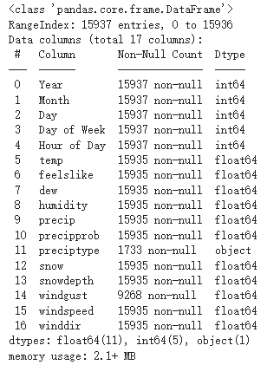
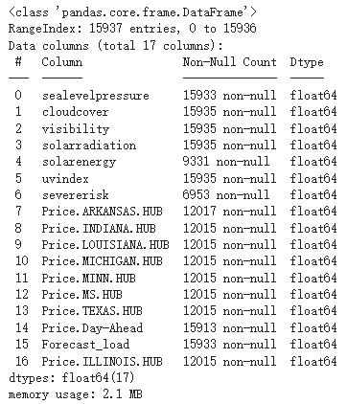
PREPROCESSING
Integrated Dataset
15937 rows (almost all the rows contain null)
34 columns (33 features + 1 label)
1 categorical feature + 32 numerical features
COMPUTER SCIENCE
XU YAN, YUNQIAN BAO, ZHICONG FAN
Notes:
We concatenated the raw data files by the timestamp and integrated it into one dataset which contains about 16 thousand rows and 34 columns.
almost all the rows have missing values, and there is a categorical feature that needs to be transformed.

Slide 11
PREPROCESSING
Data Cleaning
Missing Values
Fill with the average of the closest records.
Fill with zero
Simulate data with the same pattern
Drop
Categorical Values
One-Hot Encoding
COMPUTER SCIENCE
XU YAN, YUNQIAN BAO, ZHICONG FAN
Notes:
In the preprocessing phase, we had two tasks: Data Cleaning and Visualization. Specifically, we need to deal with missing values and categorical values.
For missing values, we applied four methods: Fill with the average of the closest records, Fill with zero, Simulate data with the same pattern, and directly drop feature.
In terms of categorical values, we used one-hot encoding.
We’ll take some examples in the following slides.

Slide 12
PREPROCESSING
Data Cleaning & Visualization
Fill with the average of the nearest records:
Situation: Occasional breakpoints in continuous values
i.e. temperature, sea level pressure
Fill with zero:
Situation: NaN which means zero in the context.
i.e. windgust, solar energy
COMPUTER SCIENCE
XU YAN, YUNQIAN BAO, ZHICONG FAN
Notes:
We found that the weather information loses 2 hours of data in a two year scale, which means they are breakpoints in a continuous value stream. Therefore, we can fill the missing values with the mean of the nearest records.
Wind gust means a brief increase in the speed of the wind. We found that wind speed is zero when windgust is Nan, so we can assume that the null value in windugust means 0.
We fill the occasional breakpoints in a continuous value with the average of the nearest records.
And fill the null values which means zero in the context with zero.

Slide 13
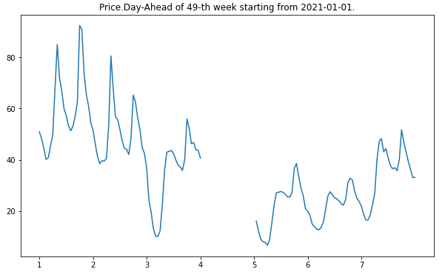
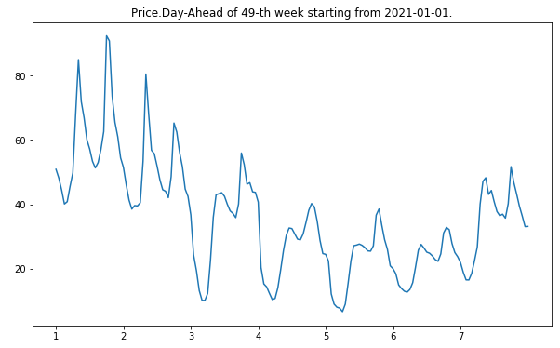
PREPROCESSING
Data Cleaning & Visualization
Simulate with the same pattern:
Situation: Missing data in small piece, and follows a specific pattern.
i.e. Day-Ahead Price misses data of Thursday in the 49th week.
Data on Thursday and Friday has similar pattern
COMPUTER SCIENCE
XU YAN, YUNQIAN BAO, ZHICONG FAN
Notes:
In the 49th week from 2021 new year, the Day-Ahead Price of Thursday is missing. By looking up the plot for the nearest weeks, we found that the pattern of Thursday is similar to the pattern of Friday, but the pattern of Thursdays in different weeks varies. Therefore, we decided to get the polynomial function for the data on Friday and simulate the data of Thursday with that function.

Slide 14
PREPROCESSING
Data Cleaning & Visualization
Drop:
Situation 1: Missing data in a big chunk.
i.e. severisk is NaN for 2021.
Situation 2: Data that should not be manipulated.
i.e. Price of Illinois is the label.
COMPUTER SCIENCE
XU YAN, YUNQIAN BAO, ZHICONG FAN
Notes:
Unfortunately, we have to drop some features since they are unable to fill with reasonable values. For example, the severisk is null for a whole year.
In addition, our label, the price of Illinois, has null value. We are not allowed to make any change to our label, and they are missing in all the database in MISO organization, so we have to drop it.

Slide 15
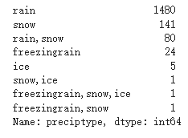
PREPROCESSING
Data Cleaning & Visualization
Categorical Value - Precipitation
One-Hot Encoding
COMPUTER SCIENCE
XU YAN, YUNQIAN BAO, ZHICONG FAN
Notes:
The precipitation feature describes the precipitation type, including 8 values. We applied one-hot encoding on it and transform it to binary value, because we will not use decision trees in this project.

Slide 16
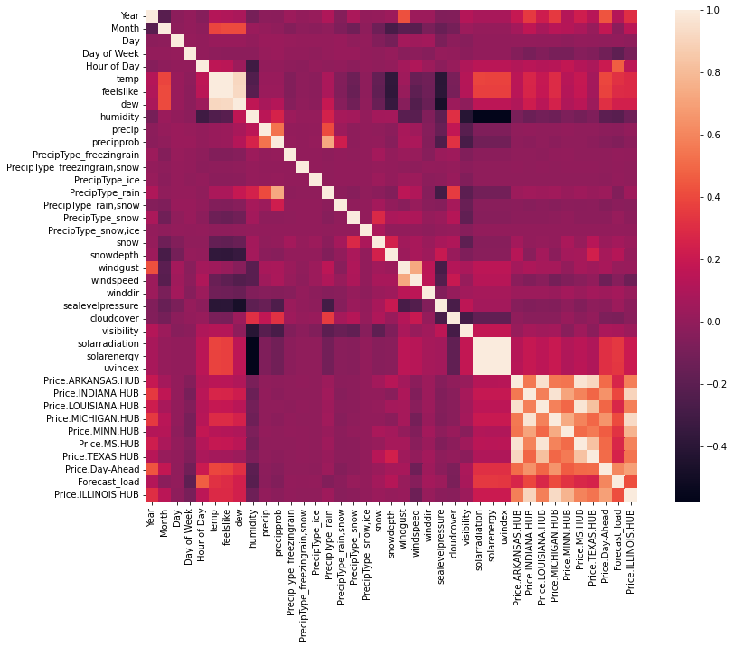
PREPROCESSING
Linear Correlation
Drop high-correlated features
['temp', 'feelslike']
['solarradiation', 'solarenergy', 'uvindex']
['Price.LOUISIANA.HUB', 'Price.ARKANSAS.HUB', 'Price.MS.HUB']
['Price.INDIANA.HUB', 'Price.MICHIGAN.HUB']
COMPUTER SCIENCE
XU YAN, YUNQIAN BAO, ZHICONG FAN
Notes:
After handling all missing values, we make a linear correlation plot for all the features.
Notice that there are four chuck of features have high positive / negative correlation. We only keep one from each group to lighten the burden of models.

Slide 17
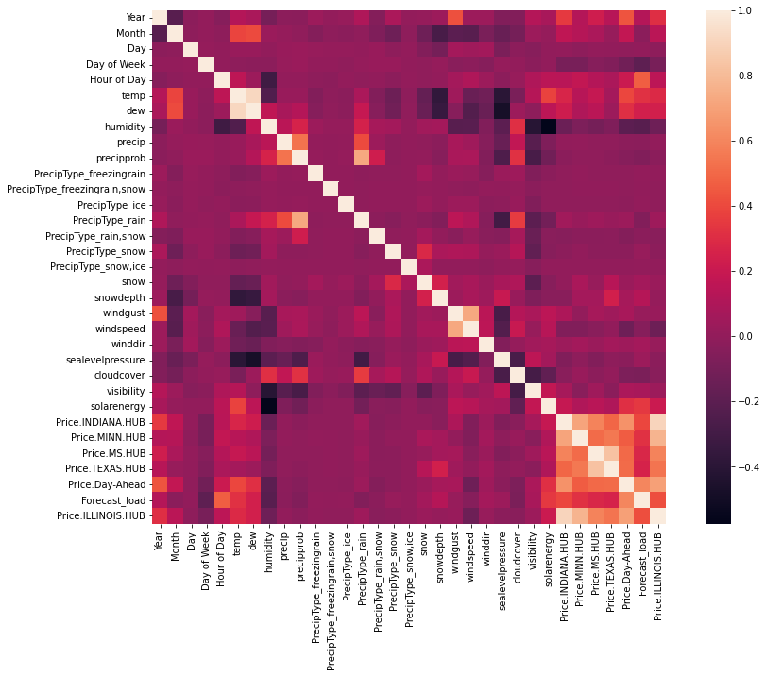
PREPROCESSING
Linear Correlation
After deleting high-correlated features
COMPUTER SCIENCE
XU YAN, YUNQIAN BAO, ZHICONG FAN
Notes:
This the linear correlation plot after dropping duplications.

Slide 18
MODELS
COMPUTER SCIENCE
XU YAN, YUNQIAN BAO, ZHICONG FAN

Slide 19
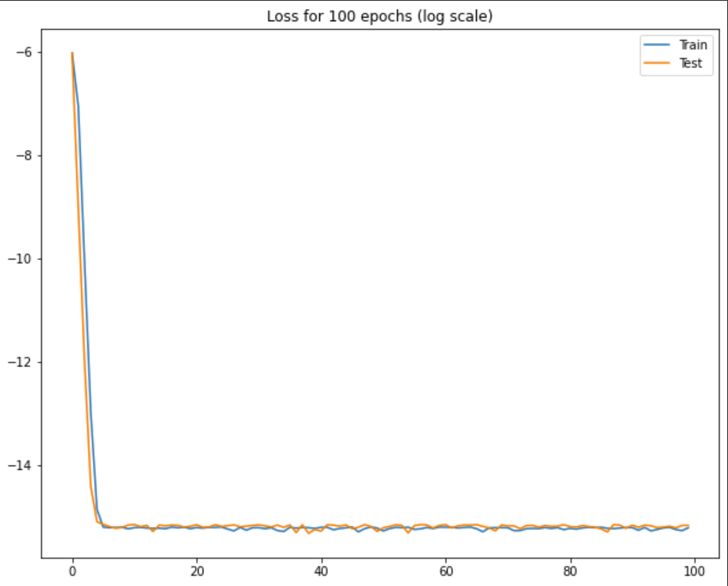
MODELS
Linear Regression
To set as a benchmark, we set up a simple one-layer linear model.
Map 32 features to the target
Every batch size contains about 1 month of data
L2 norm
SGD optimizer
100 epochs
COMPUTER SCIENCE
XU YAN, YUNQIAN BAO, ZHICONG FAN

Slide 20
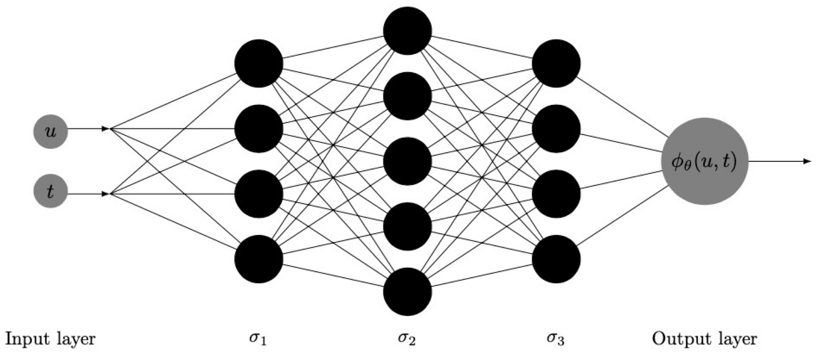
MODELS
Multi-Layer Perceptron
To proceed, we first come out with a MLP model
Three hidden layers
Activation: ReLU
Dropout
Normalized data (max-min-scaler)
Optimizer : SGD , ADAM
Batch Size: 500, 1000
Epochs: 500
COMPUTER SCIENCE
XU YAN, YUNQIAN BAO, ZHICONG FAN

Slide 21
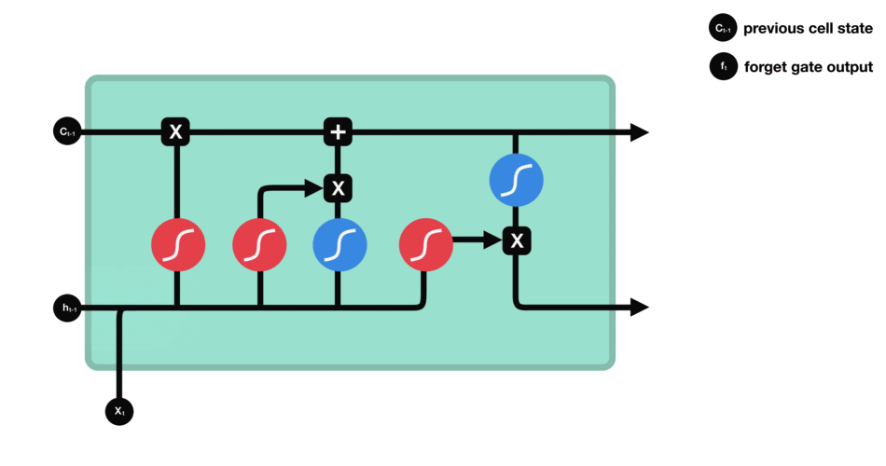
MODELS
Long Short-term Memory Model
Furthermore, we then come out with an LSTM model
50 length
25 hop
1,2,3 hidden layers with size starting from 128 to 1024
Optimizer: SGB, ADAM
Batch_size: 128, 256, 512
COMPUTER SCIENCE
XU YAN, YUNQIAN BAO, ZHICONG FAN

Slide 22
DISCUSSION
COMPUTER SCIENCE
XU YAN, YUNQIAN BAO, ZHICONG FAN

Slide 23
DISCUSSION
Linear Regression (Benchmark)
With Kfold
Split into 10 and use 3 as test.
Fold 1: train MSE 256.908948; test MSE 320.811456
Fold 2: train MSE 171.381858; test MSE 377.913180
Fold 3: train MSE 207.116130; test MSE 285.540244
Minimum Test MSE: 285.5
COMPUTER SCIENCE
XU YAN, YUNQIAN BAO, ZHICONG FAN
Notes:
We use the linear regression model as our benchmark. Since it is a light-scale model, we applied Kfold on it. It is split into 10 folds and we use 3 of them as testset.
The minimum loss is 285, and we used it as our benchmark.

Slide 24
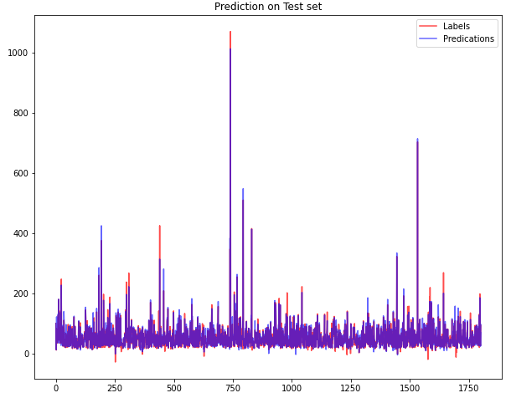
DISCUSSION
Hyperparameter Search on Deep Nets
MLP
Config pool:
Batch size:
Hidden layer 1 size:
Hidden layer 1 size:
Hidden layer 1 size:
Dropout:
Optimizer:
Learning Rate:
Observation
Models with SGD converges faster than models with ADAM in general, but the best result is generated by model with ADAM.
When using a batch size of 1000, the loss is generally larger than the model with batch size of 500.
Degradation in ability to generalize
The dropout rate is 0 since dropout is usually used on image projects and seldomly used on plain numerical data.
[500, 1000]
[16, 32, 48]
[32, 64, 96]
[16, 32, 48]
[0, 0.1]
[SGD, ADAM]
[0.1, 0.01, 0.001, 0.0001]
The loss 130.98 is 54.4% of the benchmark 285.
COMPUTER SCIENCE
XU YAN, YUNQIAN BAO, ZHICONG FAN
Notes:
For MLP, We use Ray as our hyperparameter search tool to find the best combination of model config and other hyperparameters. We found that Models with SGD converges faster than models with ADAM in general, but the best result is generated by model with ADAM. Second, when using a batch size of 1000, the loss is generally larger than the model with batch size of 500. We consider that it is due to the degradation in ability to generalize. Large-batch methods tend to converge to sharp minimizers of the training function. The best result occurs on the model with relatively large numbers of perceptrons in hidden layers. The dropout rate is 0 since dropout is usually used on image projects and seldomly used on plain numerical data. The learning rate is 1e-3, which is not so large.
The minimum loss is 131 which is only 54% of the benchmark. And this is the comparison chart between prediction and label.

Slide 25
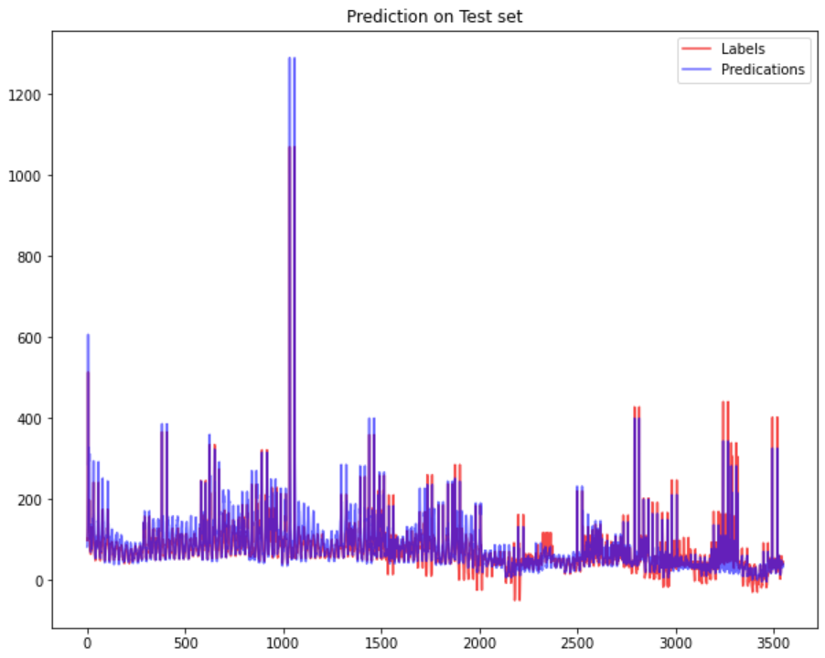
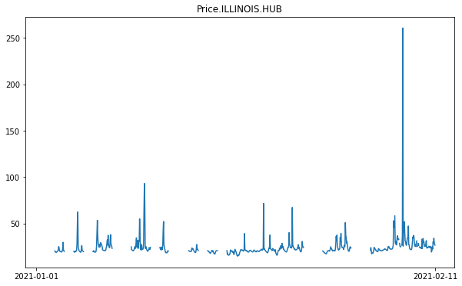
DISCUSSION
Hyperparameter Search on Deep Nets
LSTM
Config pool:
Batch size:
Hidden layer 1 size:
Hidden layer 1 size:
Hidden layer 1 size:
Optimizer:
Learning Rate:
Observation
Best optimizer: ADAM
The larger batch size we had, the worse training loss we would get. The best batch size we could have is 256.
The hidden layer size plays a significant role in this play. The best tried hidden layer size is 512.
[128, 256, 512]
[128, 256, 512, 1024]
[128, 256, 512, 1024]
[128, 256, 512, 1024]
[SGD, ADAM]
[0.1, 0.01, 0.001, 0.0001]
Result
Minimum Test MSE: 370.66790771484375
COMPUTER SCIENCE
XU YAN, YUNQIAN BAO, ZHICONG FAN
Notes:
In terms of LSTM, using the grid search, we found that the best optimizer is adam, since the lowest two losses are both produced by adam within similar training total time.
For adam optimizer, we can see that the larger batch size we had, the worse training loss we would get. The best batch size we could have is 256.
We also found that the hidden layer size plays a significant role in this play. In both cases for SGD and adam optimizers, if we have too large hidden layer size, the training time would drastically increase, and however, we could not get better results. The best tried hidden layer size is 512.
The minimum loss we can get is 370 which is higher than the benchmark. We conclude that it is because of the missing values. This is a plot of our label, the missing value destroys the time-sequentiality which LSTM relies on. Therefore, it makes sense that LSTM performs worse than MLP and even the benchmark.

Slide 26
THANKS
Noam Yan (xuy3@illinois.edu)
Yunqian Bao (yunqian4@illinois.edu)
Zhicong Fan (zhicong2@illinois.edu)
COMPUTER SCIENCE
XU YAN, YUNQIAN BAO, ZHICONG FAN

Slide 27


